Slide 1

Git
The right way for version control

Slide 2
Git =/= Github
Git is a software.
GitHub is a website who provides git repo service.

Slide 3
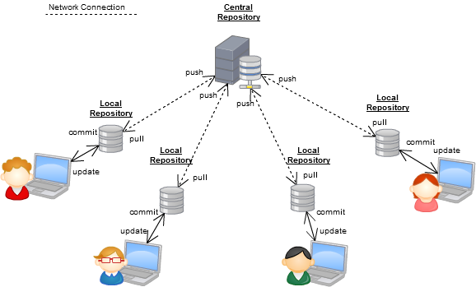
Distributed VCS

Slide 4
Basic git commend
git init
git clone
git push
git pull
git add
git delete
git commit
git merge

Slide 5
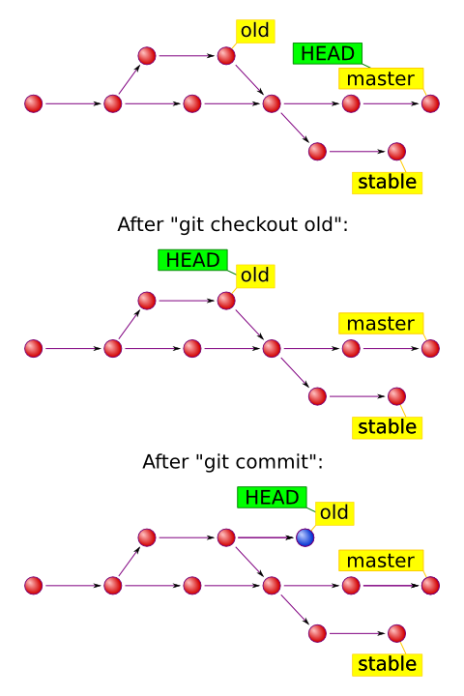
Branches
master
  Only the latest stable version
feature
  feat_#ticket_no
  Any new feature develops on it’s own branch
bug
  bug_#ticket_no
  As feature branch
dev
  alpha version, working but might has minor bugs
personal branches
  p_name
  Anything not in issue tracking system
  POC
  research
  etc...

Slide 6
Deployment
Capistrano --SSH--> server --GIT--> GitHub
Apache VirtualServer (For multistage control on one server)
Deploy only master branch

Slide 7
Capistrano
Pro
  Correctly, no file left behind.
  Failsafe, rollback anytime.
  Secure, no need FTP service on server.
  Unix friendly
Con
  Not very Windows friendly.
  Require more effort if the deployed target server is a Windows server.
  Require more understanding of Unix and Ruby for making deploy script.

